Slide 1
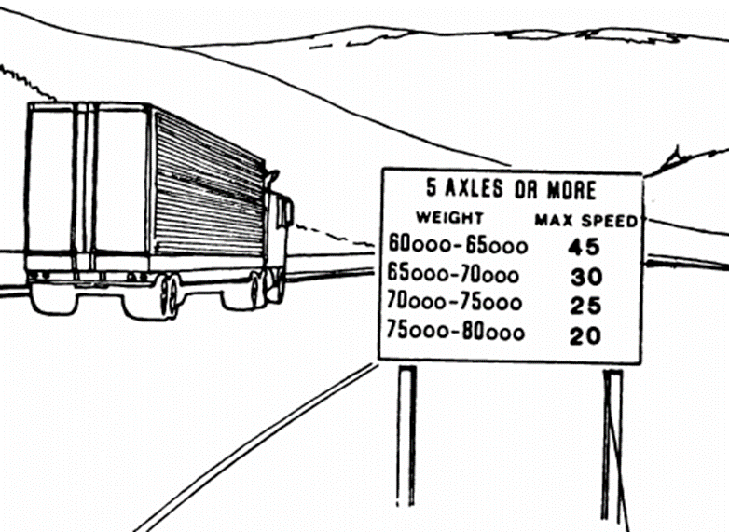




GSRS Phase II: Automating the Implementation of the Updated GSRS And Validation Tests for Truck Drum Brakes
Project Investigators
Vincent Ampadu
Muhammad Tahmidul Haq, Ph.D., P.E.
Khaled Ksaibati, Ph.D., P.E.
November, 2021

Slide 2
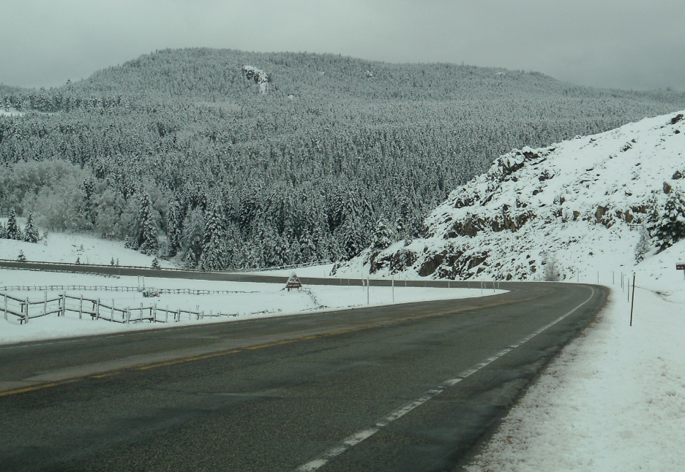
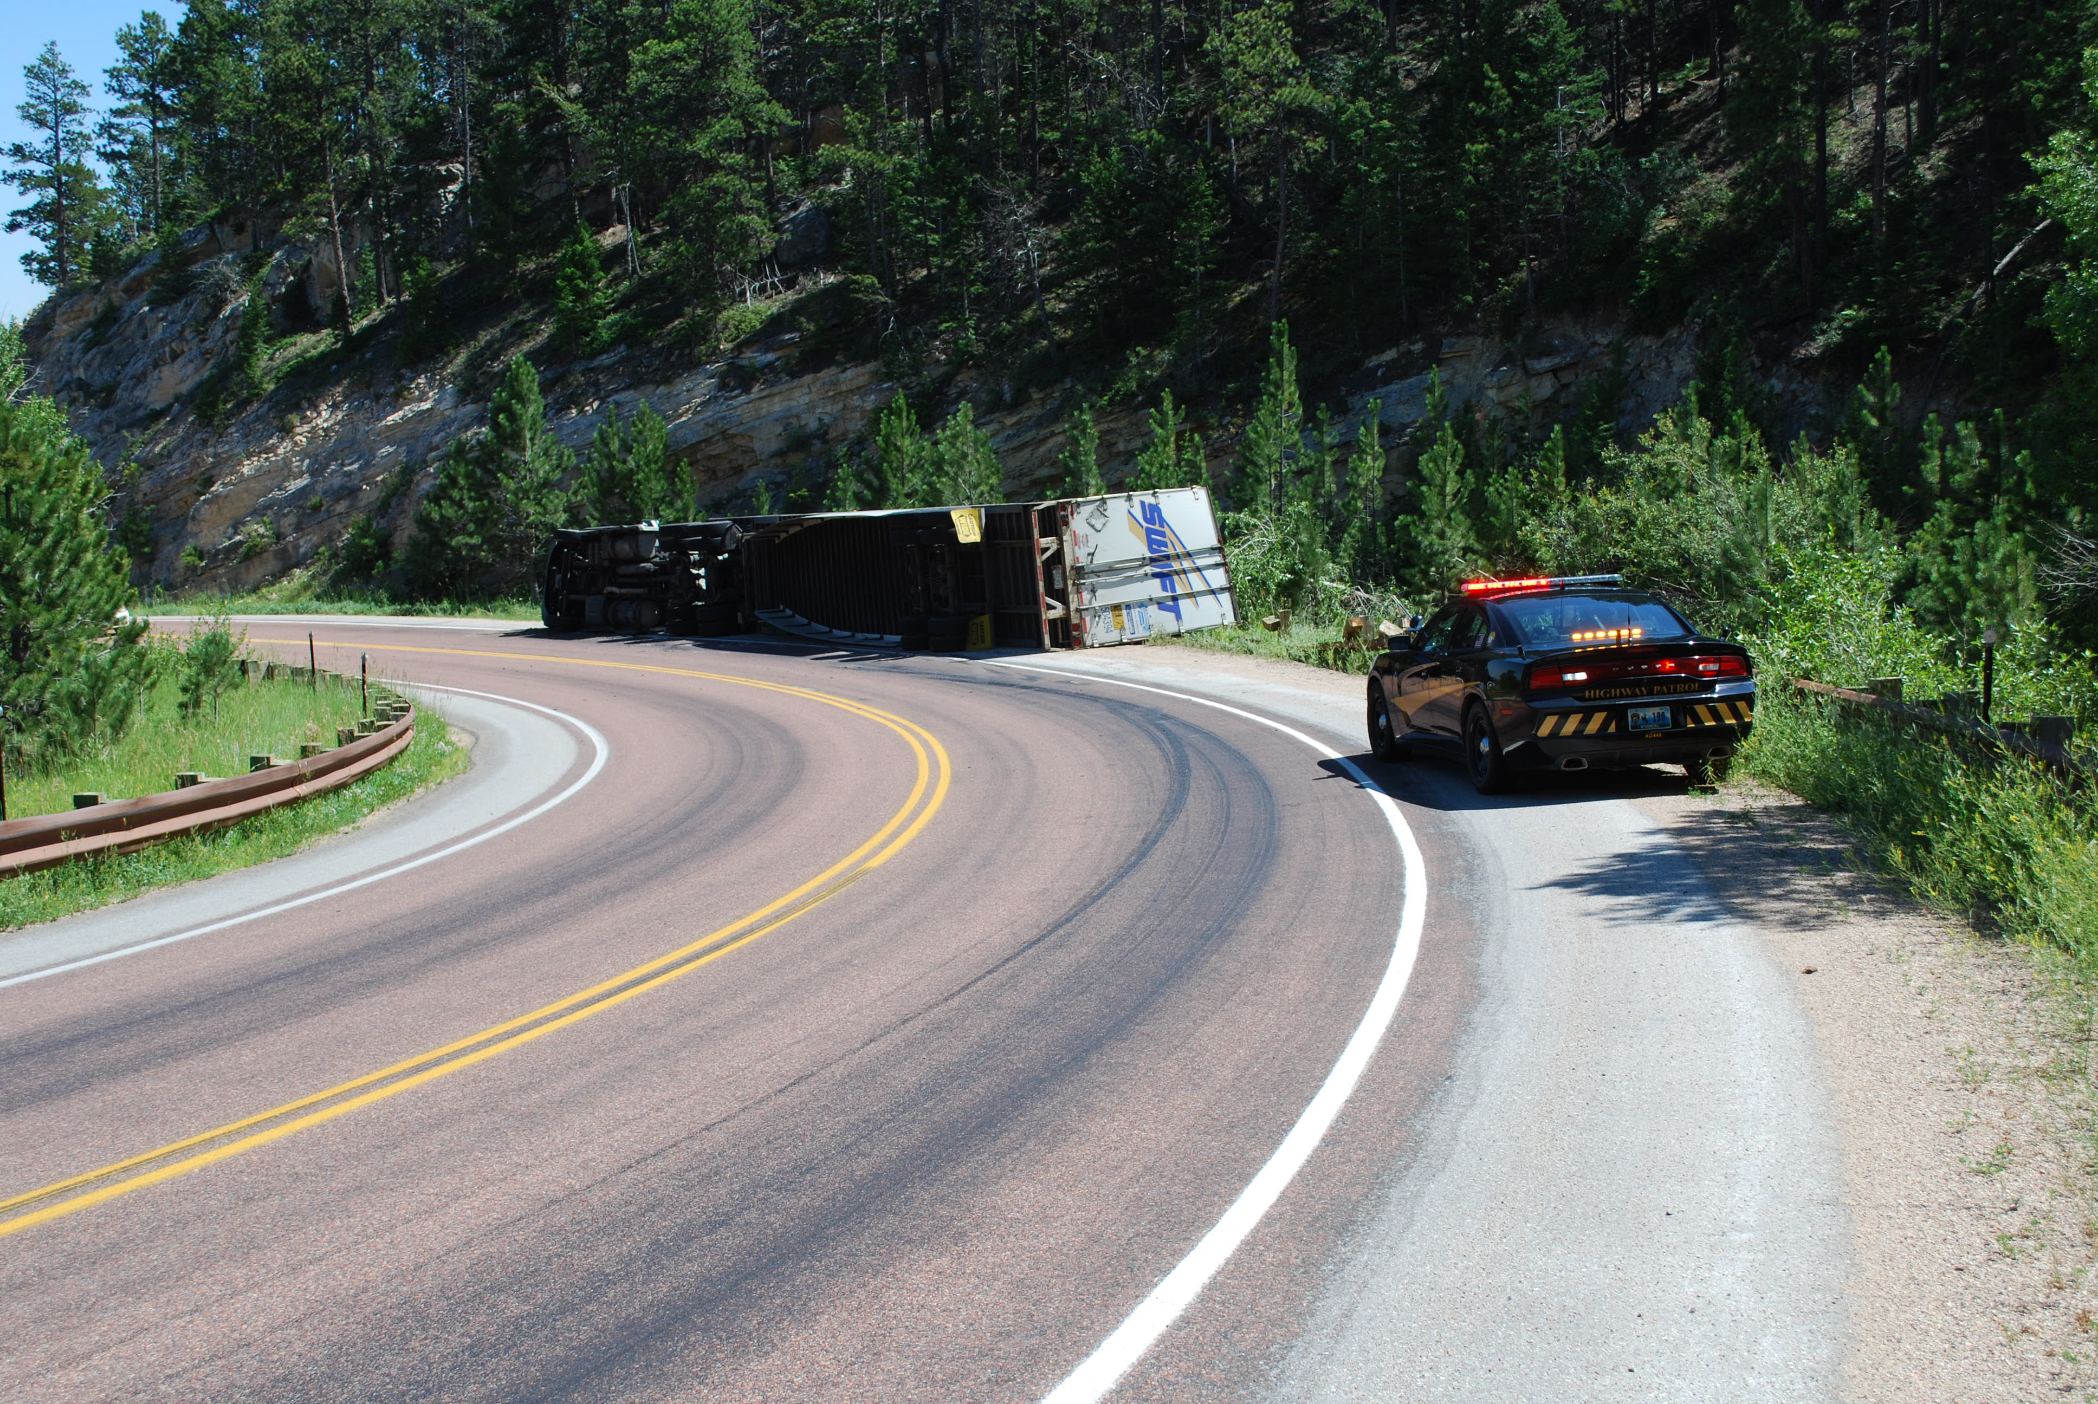
Background
Truck downgrade braking has long been a problem for truck drivers on steep downgrades
Downgrade crashes occur when truck brake temperature exceeds critical braking temperature
This phenomenon is called brake fade and leads to a truck runaway event with costly consequences
The FHWA developed a Grade Severity Rating system (GSRS) Model, which used together with Weight Specific signs (WSS) enables the driver to select appropriate speeds during downgrades to avoid “fade”
A prior study updated the parameters of the GSRS using an instrumented vehicle which took into account current truck configurations and braking systems

Slide 3
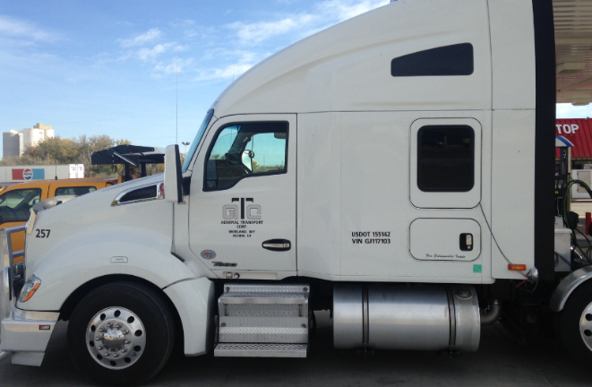
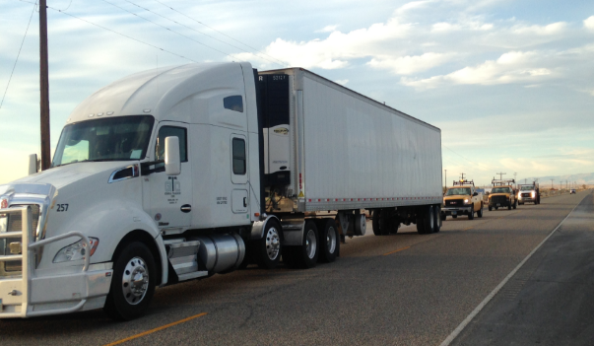
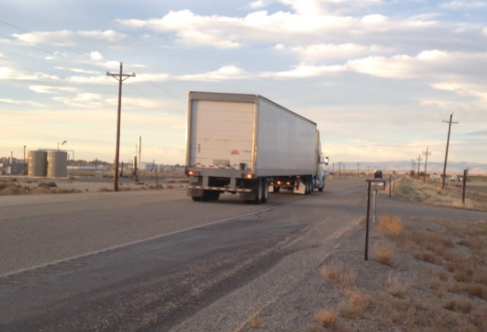
Overview of the GSRS Field Test
In the previous study, a 2016 Kenworth T-680 truck with front air disc brakes and rear drum brakes was used for the field tests
Since disc brakes account for only 20% of the brake market, the model needs to be validated for trucks fitted with only drum brakes
Truck instrumentation is not required for the GSRS field tests
The procedure consists of
Hill Descent test on 06/29/2021 (Tue) and
Validation test on 06/30/2021 (Wed)

Slide 4



Testing Details
Traffic Control
Test Vehicle preparation
Equipment
Test locations
Scheduling
Data Collection Form

Slide 5
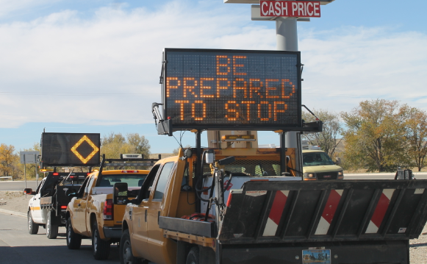
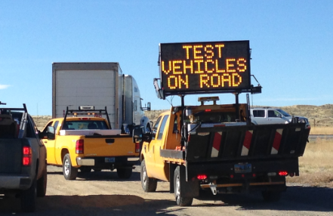
Traffic Control
Traffic control was provided by WYDOT
Radio broadcasts were made to inform residents within the vicinity of the test locations

Slide 6
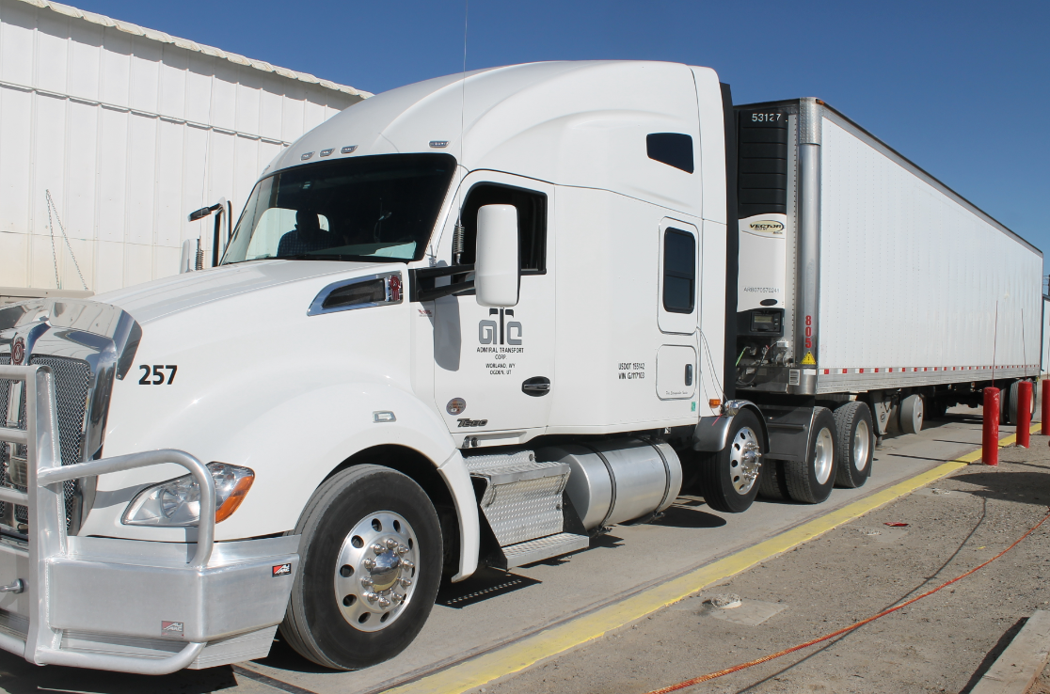
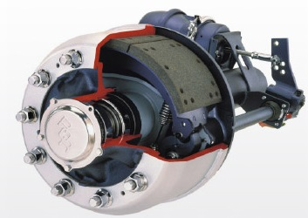
Test Vehicle
2010 Freightliner Cascadia with sleeper in a 3-axle all drum configuration + 53' dry van trailer with a 2-axle all drum configuration.
Brakes – Drum Configuration
Weight
Day 1 (06/29/2021) – 80,000 lbs for Hill descent test
Day 2 (06/30/2021) – 70,000 lbs for Validation test

Slide 7
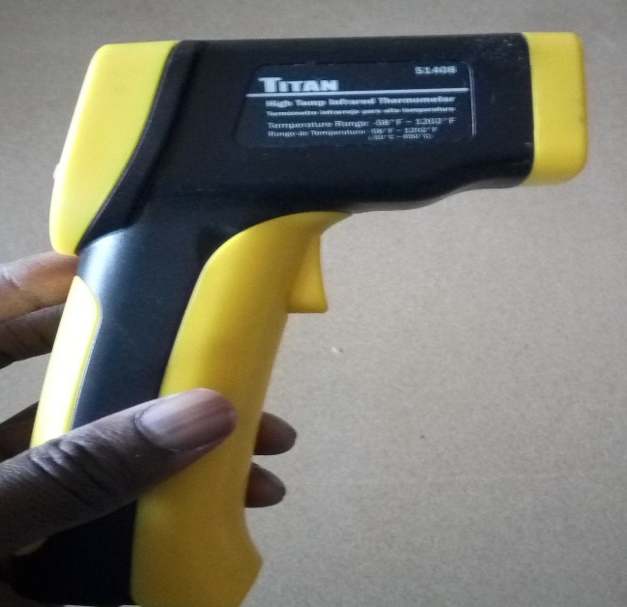
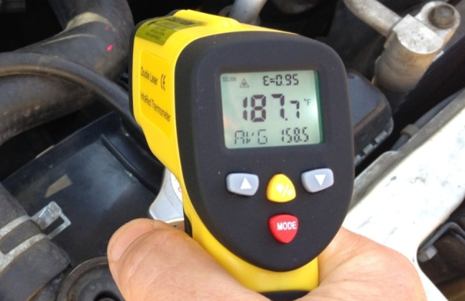
Equipment
Hand-held sensors
Ambient temperature measuring device (Some smartphone apps) and alternate devices for confirmation
Timer

Slide 8
Test Details
Day 1: 06/29/2021 (Tue) – Hill Descent Test
Meeting location at 921 Pulliam Avenue, Worland
Three separate segments with six turning spots
Two test runs per segment
Speed:
Segment HD-I: 30 and 40 mph
Segment HD-II: 35 and 45 mph
Segment HD-III: 40 and 50 mph
Day 2: 06/30/2021 (Wed) – Validation Test
Meeting location at 921 Pulliam Avenue, Worland
Two continuous segments with three stopping spots
Three test runs for the entire segment
Speed: 35, 40 and 45 mph

Slide 9
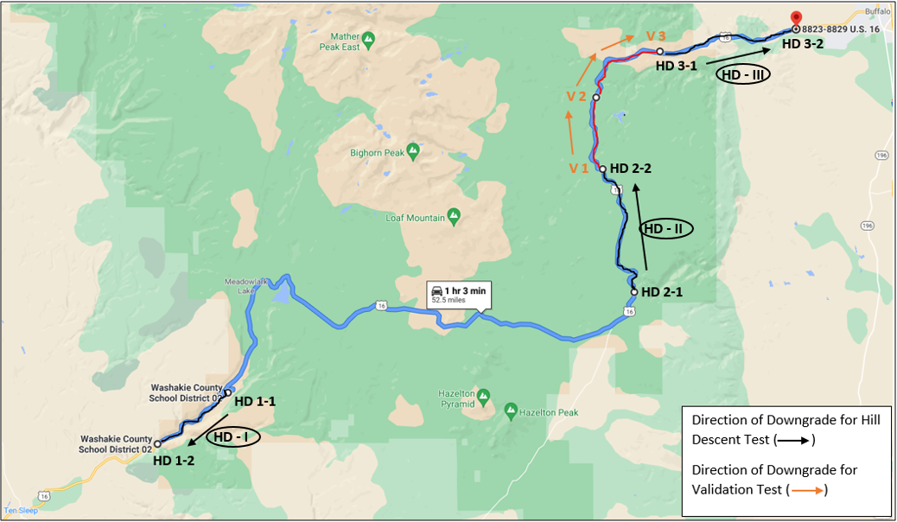

Test Location Map
Day 1: 06/29/2021 (Tue) – Hill Descent (HD) Test
Day 2: 06/30/2021 (Wed) – Validation (V) Test
(MP 82.30)
(MP 88.28)
(MP 78.77)
(MP 82.30)
(MP 74.69)
(MP 74.69)
(MP 66.93)
(MP 37.98)
(MP 33.88)

Slide 10
Test Location Co-ordinates
Day 1: 06/29/2021 (Tue) – Hill Descent (HD) Test
Three Separate Segments, Two test runs per segment
Segment | Spot ID | Coordinates | Description | Other nearest available coordinates to make U-turn
 |  |  |  | Option-1 | Option-2 | Option-3
HD – I (30 & 40 mph) | HD 1-1 (MP 37.98) | (44.108523, -107.269592) | Should be fine for stops/U-turn | (44.108489, -107.275450) (MP 39.14) | - | -
 | HD 1-2 (MP 33.88) | (44.076075, -107.331767) | Should be fine for stops/U-turn | (44.070683, -107.347721) (MP 32.87) | (44.058538, -107.387340) (MP 30.50) | (44.052005, -107.397135) (MP 29.82)
HD – II (35 & 45 mph) | HD 2-1 (MP 66.93) | (44.171708, -106.912747) | Should be fine for stops/U-turn | (44.142828, -106.960699) (MP 63.54) | - | -
 | HD 2-2 (MP 74.69) | (44.249467, -106.940798) | Most ideal location for stops/U-turn | - | - | -
HD – III (40 & 50 mph) | HD 3-1 (MP 82.30) | (44.323139, -106.890345) | Ideal location for stops/U-turn | - | - | -
 | HD 3-2 (MP 88.28) | (44.337336, -106.770569) | Ideal location for stops/U-turn | - | - | -

Slide 11
Test Location Co-ordinates
Day 2: 06/30/2021 (Wed) – Validation (V) Test
Two Continuous Segments, Three test runs with speeds of 35, 40 and 45 mph
Segment | Spot ID | Coordinates | Description
1) V 1 – V 2 2) V 2 – V 3 | V 1 (MP 74.69) | (44.249467, -106.940798) | Most ideal location for stops/U-turn
 | V 2 (MP 78.77) | (44.294364, -106.946179) | Fine for stops
 | V 3 (MP 82.30) | (44.323139, -106.890345) | Ideal location for stops/U-turn

Slide 12
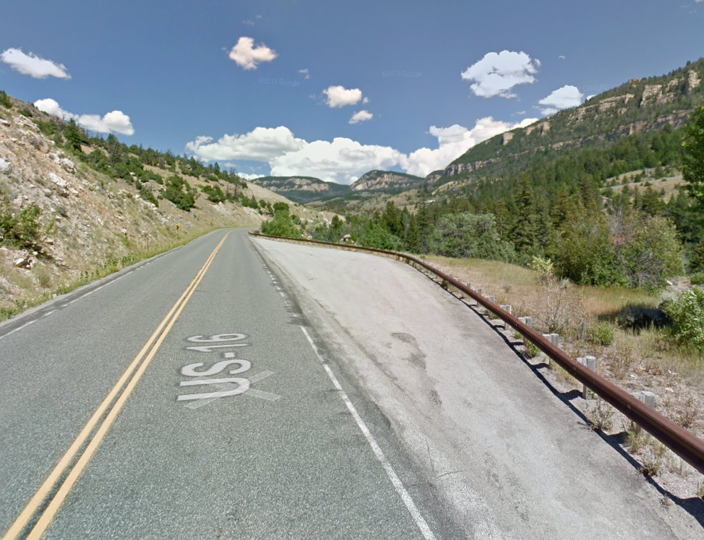
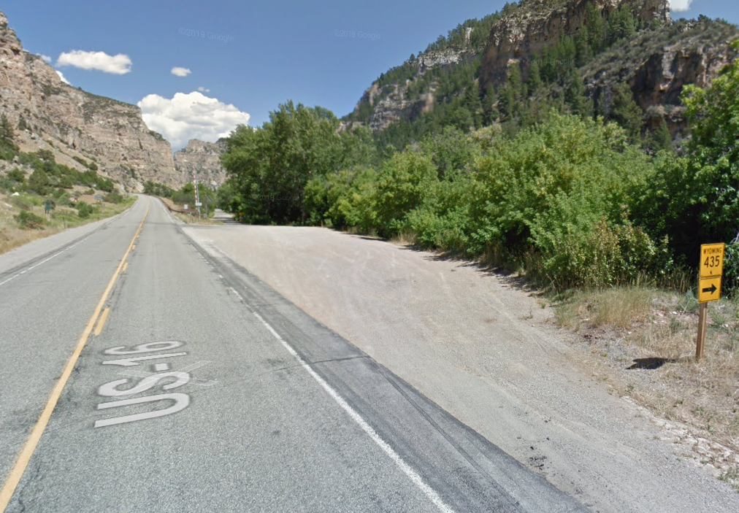
Images of Turning Locations - Hill Descent Tests
HD 1-1 (MP 37.98)
HD 1-2 (MP 33.88)

Slide 13
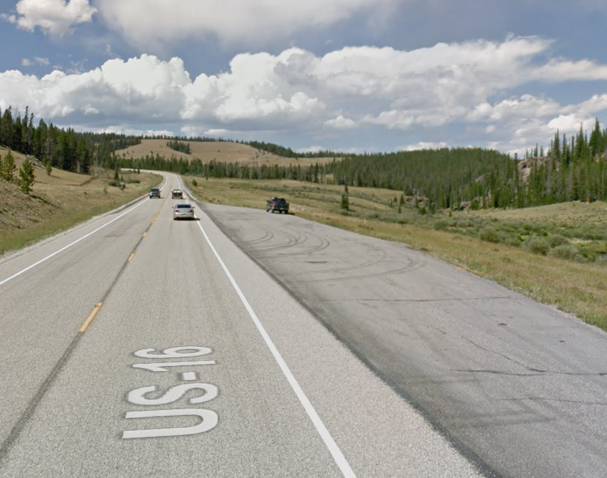
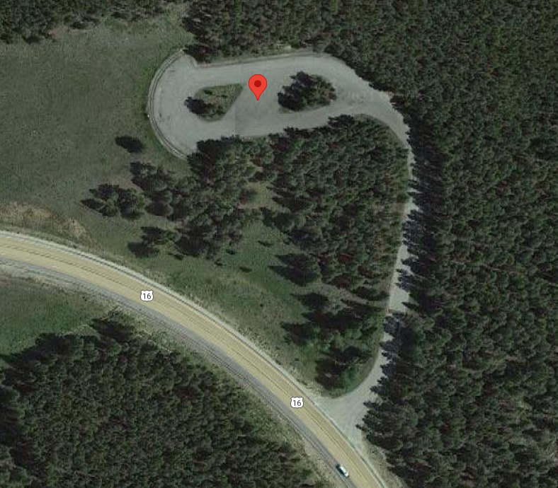
Images of Turning Locations - Hill Descent Tests
HD 2-1 (MP 66.93)
HD 2-2 (MP 74.69)

Slide 14
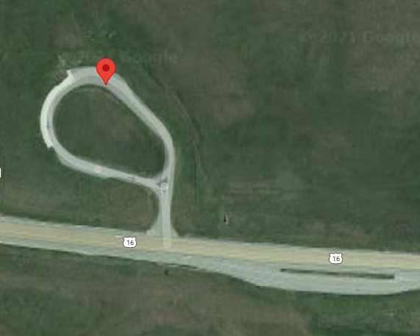
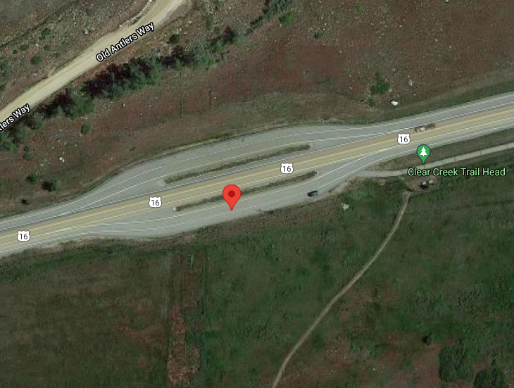
Images of Turning Locations - Hill Descent Tests
HD 3-1 (MP 82.30)
HD 3-2 (MP 88.28)

Slide 15
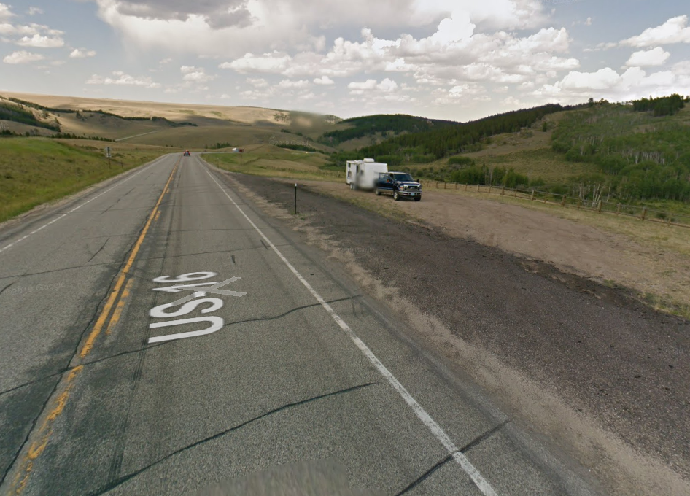
Images of Turning locations - Validation Tests
V1 (MP 74.69)
V2 (MP 78.77)
V3 (MP 82.30)

Slide 16

Detailed Breakdown of the Testing Schedule
Probable Timeline: June 29- 30
Day | Activity | Duration
1) 06/29/2021 (Tue) | Hill Descent Test (Two test runs per segment) | 10 hr
2) 06/30/2021 (Wed) | Validation Test (Three test runs for the entire segment) | 8.5 hr
Breakdown
Day 1: 06/29/2021 (Tue)
6:45 am | Meeting at 921 Pulliam Avenue, Worland (Truck Wt. 80,000 lbs)
7:00 am - 8:00 am | Drive from Worland to Segment HD - I (HD 1-1)
8:00 am - 1:30 pm | Hill Descent Tests for Segments HD - I and HD - II
1:30 pm - 2:00 pm | Lunch Break
2:00 pm - 5:00 pm | Hill Descent Test for Segment HD - III
Day 2: 06/30/2021 (Wed)
6:45 am | Meeting at 921 Pulliam Avenue, Worland
7:00 am - 8:00 am | Loading/Unloading of Trucks (Truck Wt. 70,000 lbs)
8:00 am - 9:30 am | Driving from Worland to Segment 1 (V 1)
9:30 am - 1:30 pm | Validation Tests
1:30 pm - 2:00 pm | Lunch Break
2:00 pm - 3:30 pm | Return to Worland
Timeline: June 29 - 30

Slide 17
Data Collection Form
Day 1: 06/29/2021 (Tue) – Hill Descent Test
Segment | Spot ID | Air Temp (˚F) | Brake Temperature (˚F)
 |  |  | Brake 1 | Brake 2 | Brake 3 | Brake 4 | Brake 5 | Brake 6 | Brake 7 | Brake 8 | Brake 9 | Brake 10
HD - I 30 mph | HD 1-1
 | HD 1-2
HD – I 40 mph | HD 1-1
 | HD 1-2
HD – II 35 mph | HD 2-1
 | HD 2-2
HD – II 45 mph | HD 2-1
 | HD 2-2
HD – III 40 mph | HD 3-1
 | HD 3-2
HD – III 50 mph | HD 3-1
 | HD 3-2

Slide 18
Data Collection Form
Day 2: 06/30/2021 (Wed) – Validation Test
Speed = 35 mph
Segment | Spot ID | Brake Temperature (˚F)
 |  | Brake 1 | Brake 2 | Brake 3 | Brake 4 | Brake 5 | Brake 6 | Brake 7 | Brake 8 | Brake 9 | Brake 10
1) V 1 – V 2 2) V 2 – V 3 | V 1
 | V 2
 | V 3
Speed = 40 mph
Segment | Spot ID | Brake Temperature (˚F)
 |  | Brake 1 | Brake 2 | Brake 3 | Brake 4 | Brake 5 | Brake 6 | Brake 7 | Brake 8 | Brake 9 | Brake 10
1) V 1 – V 2 2) V 2 – V 3 | V 1
 | V 2
 | V 3
Speed = 45 mph
Segment | Spot ID | Brake Temperature (˚F)
 |  | Brake 1 | Brake 2 | Brake 3 | Brake 4 | Brake 5 | Brake 6 | Brake 7 | Brake 8 | Brake 9 | Brake 10
1) V 1 – V 2 2) V 2 – V 3 | V 1
 | V 2
 | V 3

Slide 19
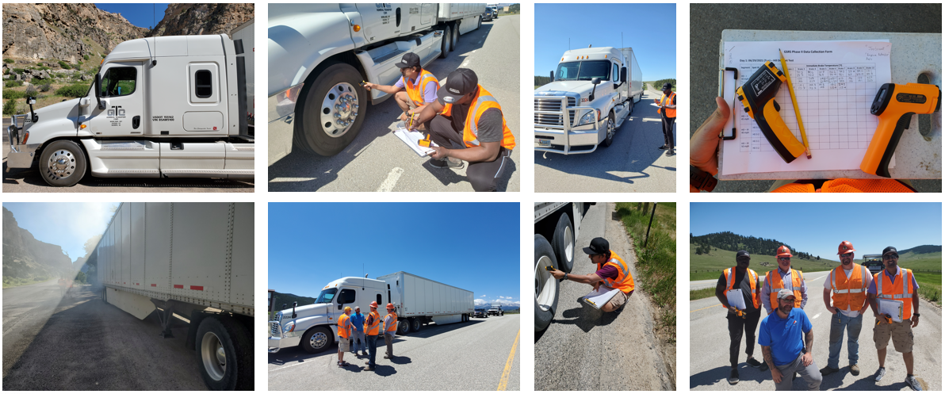
Images During the Tests

Slide 20
TEST RESULTS
Temperature parameters versus power into brakes at 32.5 mph
Temperature parameters versus power into brakes at 37.5 mph
Temperature parameters versus power into brakes at 47.5 mph

Slide 21
TEST RESULTS
Variation of heat transfer parameter with speed
An equation relating 1/K₂ to V is obtained as follows:
1/K₂ = 0.0621V - 0.9078, Thus K₂ = (0.0621V - 0.9078)⁻¹ (3)

Slide 22
Comparison of field brake temperatures and predicted brake temperatures
TEST RESULTS

Slide 23
TEST RESULTS
Input parameters of the downgrade segment used to compare the results of the two temperature models
Variable | Value
Number of Segments | 7
Maximum Brake temperature (˚F) | 500
Maximum weight for downgrade (lb) | 80,000
Maximum descent speed (mph) | 65
Initial brake temperature (˚F) | 200
Ambient temperature (˚F) | 90
Geometric information of the selected segment used for the comparison
Grade | Length (miles) | Radius (ft) | Superelevation (%) | Deflection Angle (degree)
0.01 | 0.006 | 100 | 0.04 | 81
0.01 | 0.040 | 154 | 0.04 | 80
0.02 | 0.123 | 371 | 0.04 | 100
0.03 | 0.690 | 1,500 | 0.04 | 140
0.04 | 0.040 | 144 | 0.06 | 75
0.05 | 0.112 | 340 | 0.06 | 100
0.06 | 0.660 | 1,660 | 0.06 | 120

Slide 24
TEST RESULTS
Comparison of maximum descent speeds corresponding to various weight categories between the GSRS (2016) and updated GSRS (2021) model
Max Weight (lb) | Max Speed (mph) | T Desc (˚F) | T Emerge (˚F) | T Final (˚F) | Time (min)
80000 | 60 / 60 | 252 / 252 | 90 / 90 | 342 / 342 | 03 / 03
75000 | 61 / 61 | 245 / 245 | 87 / 87 | 332 / 332 | 03 / 03
70000 | 63 / 63 | 238 / 238 | 86 / 86 | 324 / 324 | 03 / 03
65000 | 65 / 65 | 230 /230 | 85 /85 | 315 / 315 | 03 / 03

Slide 25
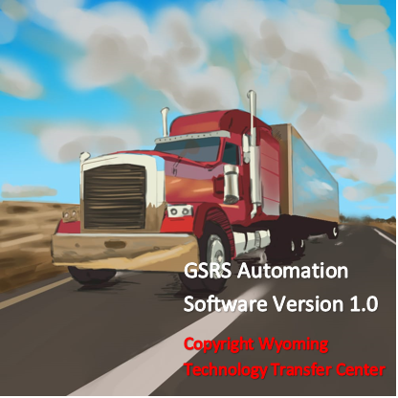
GSRS Automation Software Version 1.0

Slide 26
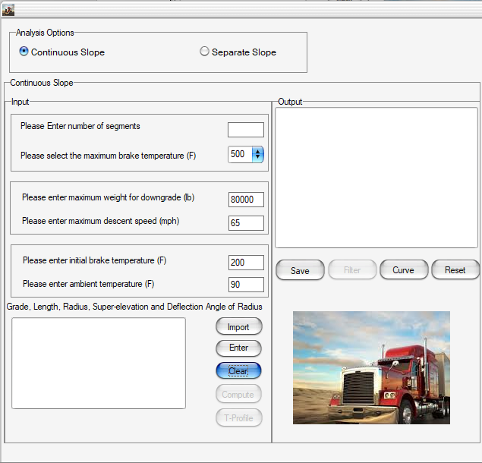
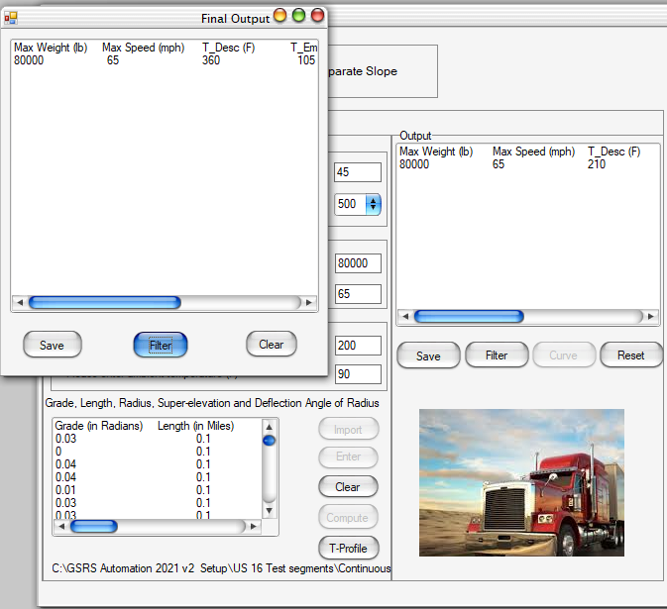
GSRS Software 1.0 - Continuous Slope Method

Slide 27
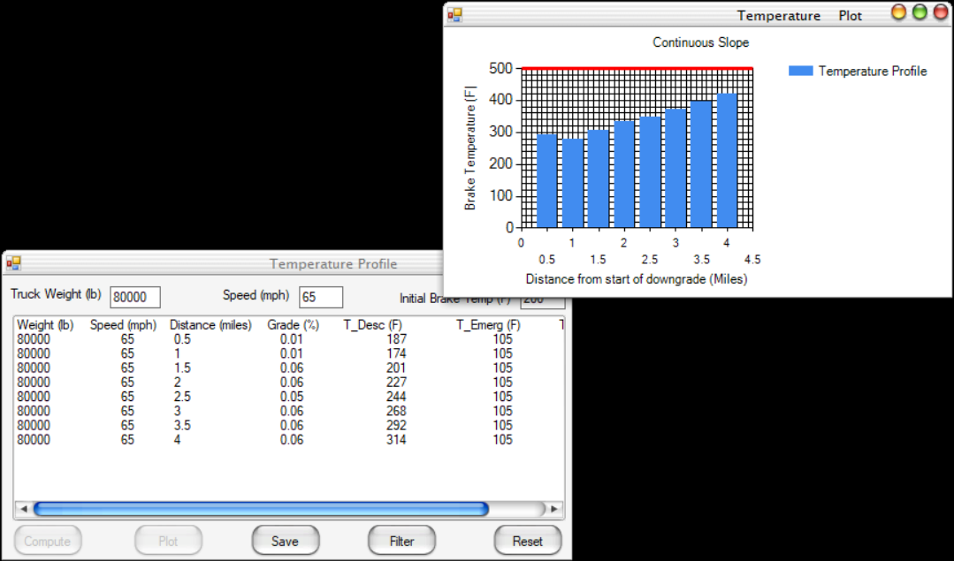
GSRS Software 1.0 – Temperature Profile

Slide 28
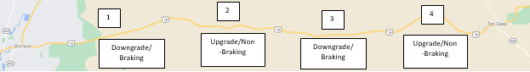
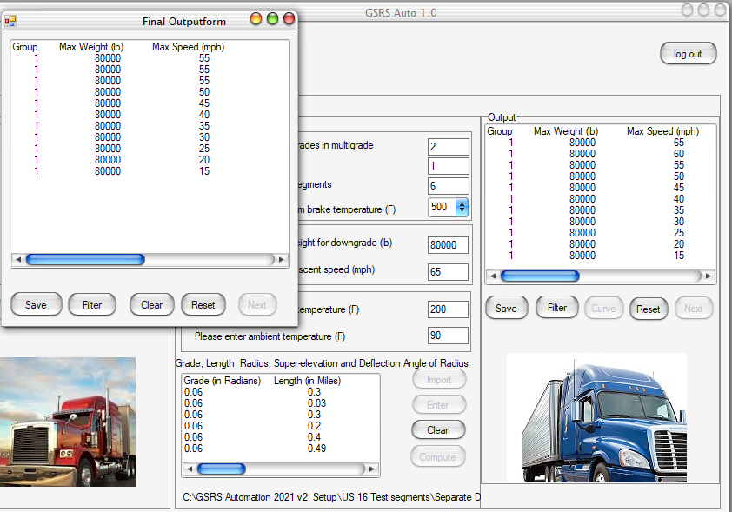
GSRS Software 1.0- Separate Downgrade Method
Braking Phase

Slide 29
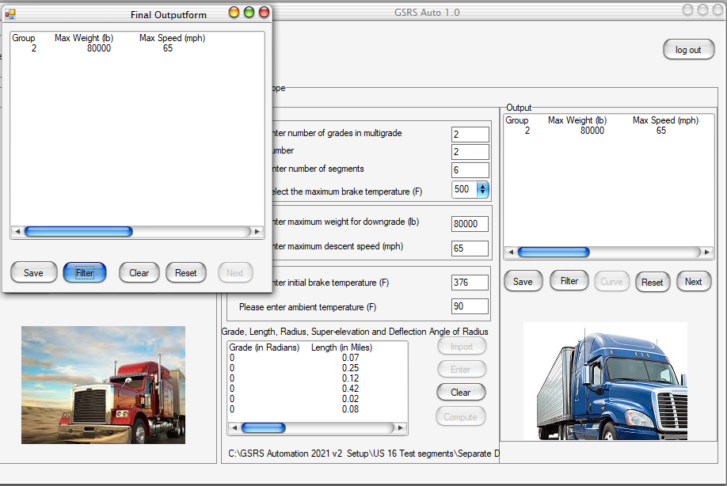
GSRS Software 1.0 – Separate Downgrade Method
Non-Braking Phase

Slide 30

Acknowledgement
Sincere gratitude to
ADMIRAL TRANSPORT CORP. for providing the Truck
WYDOT for taking care of the Traffic Control

Slide 31
Q & A
Thank you!
Questions please?

Slide 32
Demo for GSRS 1.0

